Slide 1



IBM
STERLING
PRESENTATION
https://arcanainfo.com/

Slide 2




Introduction
Overview
Contents
Why IBM Sterling?
Comparison
Conclusion

Slide 3


INTRODUCTION

Slide 4

Introduction
Sterling Connect:Direct is a robust, scalable file transfer solution designed for high-volume, secure, and reliable data exchange between systems. It is commonly used in industries such as banking, retail, and logistics, where large volumes of critical business data need to be transferred securely and efficiently.
CONTINUE
IBM Sterling Documentation

Slide 5
OVER-VIEW

Slide 6

Market Share
Over-View
IBM Sterling Connect:Direct is the leading enterprise-grade file transfer solution designed for secure, reliable, and high-volume data exchange across diverse systems. It enables businesses to streamline their file transfer processes, improve operational efficiency, and maintain compliance with regulatory standards, making it the ideal choice for organizations that rely on the timely and secure exchange of critical business data.
CONTINUE

Slide 7
FEATURES

Slide 8

Features
IBM® Sterling Connect:Direct® is a robust, point-to-point file transfer solution designed for high-volume, secure, and reliable data exchange within and between enterprises. Key features include:
1
Automated Scheduling and Recovery
2
Security-Rich Transfers
3
High-Performance Data Handling
4
Cross-Platform Support

Slide 9
Features
IBM® Sterling Connect:Direct® is a robust, point-to-point file transfer solution designed for high-volume, secure, and reliable data exchange within and between enterprises. Key features include:
1
Comprehensive Audit Trails
2
Flexible Integration Options
3
Data Compression and Protocol Support

Slide 10
USE CASES

Slide 11


The Future of Machine Learning in AI: Trends and Opportunities
ML is continuously evolving, with emerging trends like federated learning, explainable AI, and quantum machine learning. These advancements hold immense potential for solving complex problems and shaping the future of AI.
1
Healthcare Data Exchange
2
Retail and E-Commerce Operations
3
Banks

Slide 12
WHY?

Slide 13

WHY IBM Sterling?
Trusted Leader
End-to-End Security
Automation
Scalable
Real-Time Monitoring
Seamless Integration
Cost-Effective
Industry-Ready
CONTINUE

Slide 14
CONCLUSION

Slide 15

Conclusion
In conclusion, IBM Sterling Connect:Direct is a trusted and highly efficient solution for secure, high-volume, and mission-critical file transfers. Its focus on reliability, automation, and scalability makes it an indispensable tool for enterprises that need to ensure the integrity and efficiency of their data exchanges. While it excels in file transfer capabilities, its seamless integration with broader enterprise systems ensures that organizations can meet their evolving business and compliance requirements. Sterling Connect:Direct continues to be a cornerstone for secure and reliable data movement in modern business ecosystems.

Slide 16
COMMAND LINE INTERFACE

Slide 17
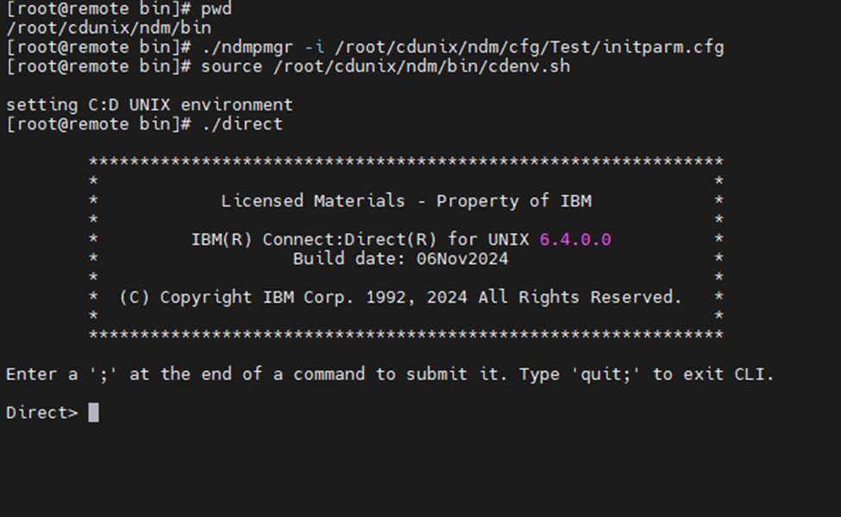

Slide 18
THANK YOU

